Slide 1


Skype for Business
Steve Buckner / Nick Cochran Information Technology
Notes:
Welcome, my name is Steve- I am the new guy in IT
Nick Cochran will be joining us in a bit once we get in to the demo
We are in the process of rolling out Office 365 to all users here in Mattawan (show install doc)

Slide 2

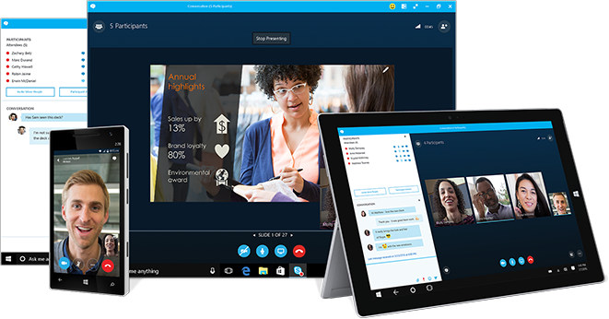
: Fundamentals
Description
This course is an introduction to Skype for Business and how it is used by MPI / Charles River.
We will be covering the, value, features and capabilities of Skype for Business. No previous knowledge is needed.
Learning Objectives
What is Office 365
How to use the Contacts List
Using Instant Messaging
How to create an impromptu meeting
How to join a meeting
How to schedule a Skype meeting
How to record a meeting
How to control participants
How to use tools for collaborating
Q&A
Notes:
Any questions that pertain to the slide we are on. Left some time at the end for QA

Slide 3

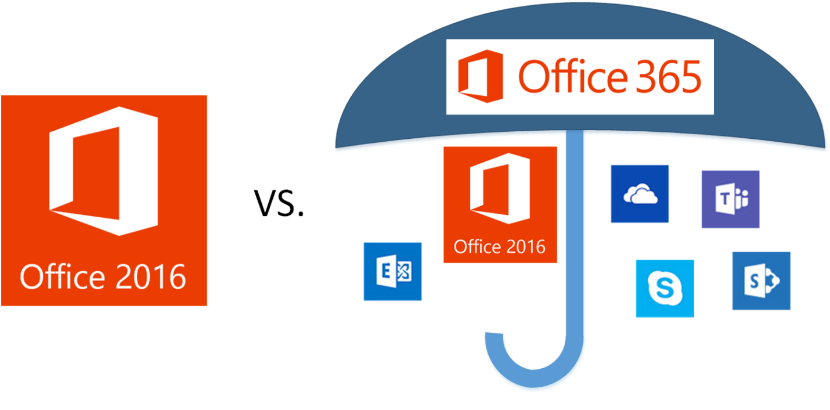
What is Office 365?
How is our location configured?
How is Charles River configured?
When do I get it?
Notes:
Replaces the stand alone / one-time purchased versions of MS Office with a subscription.
Still get your desktop software, also get other services; Exchange online hosted email, OneDrive for business, SharePoint online, Skype for Business.

Slide 4
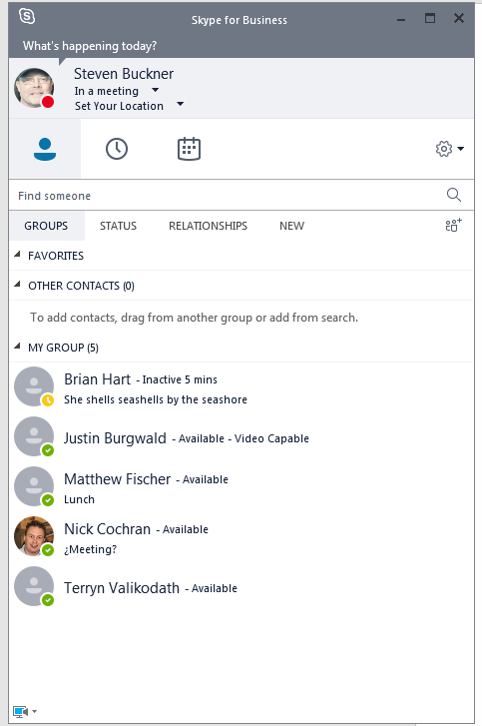
How to use the Contact List
The Contact List is the main client within Skype
What’s happening today?
Presence indicators.
Setting your availability.
Setting location.
Change photo
Adding a contact.
Selecting your primary device.

Slide 5
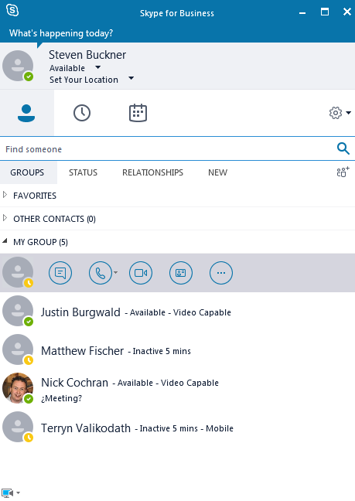
Using Instant Messaging
Learning Objectives
IM Nick
Send Nick a pic
Send Nick a Link
Explain Audio
Audio Nick
VID Nick
Sharing files.
Impromptu Meeting. Audio call / video call.
Notes:
IM, Audio, VID Nick
Audio and Video call will use devices on your PC.
Audio – Desktop or Laptop speakers – or if you have a PC headset.
Video – Will use the camera on your laptop if it is enabled.

Slide 6
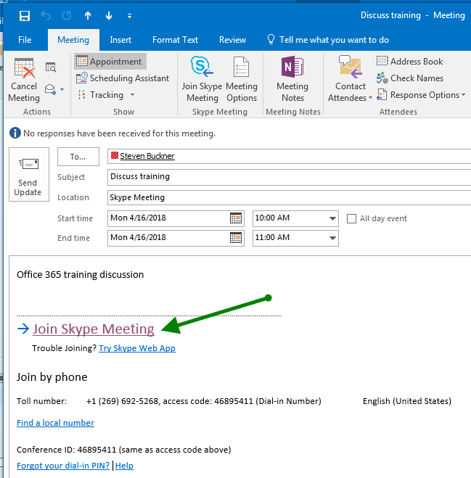
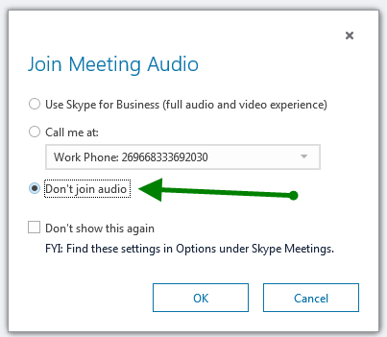
How to Join a Skype Meeting
Joining Steps
Open Outlook and go to your calendar
Join meeting audio options
Notes:
Joining a meeting that you have been invited to, not that you have scheduled.
We will discuss scheduling and starting a meeting in a bit
Describe our Audio and Video setup
Generally best to start a meeting through Outlook

Slide 7
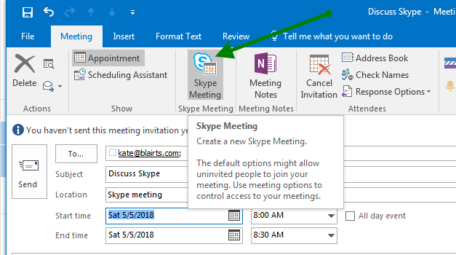
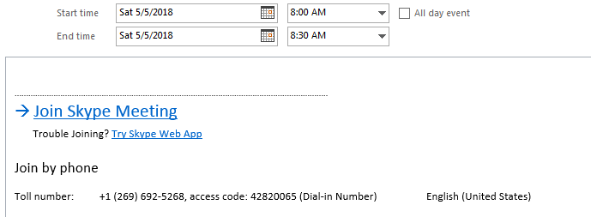
How to Schedule a Skype Meeting
Scheduling Steps
Open Outlook and go to your calendar
Conference # needs Audio Conf license
Set up the meeting as you typically would
Select Skype Meeting
Notes:
Need Audio Conferencing license activated on your Office 365 account you will be hosting meetings

Slide 8

Before starting your meeting
Learning Objectives
Practice
Start meeting at least 10 minutes before scheduled start time.
Recording a meeting?
Check your primary device
Notes:
echo123@skypeids.net –
https://teamsnet.unesco.org/sites/S4B/Pages/Skype-TEST.aspx

Slide 9
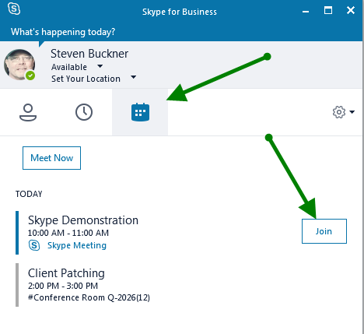
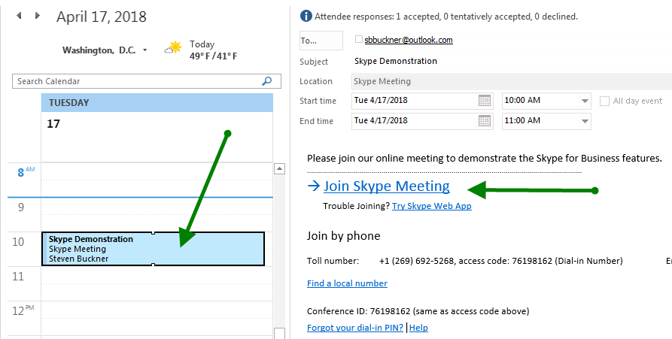
Starting a Skype Meeting
Learning Objectives
Launching from Outlook 2016
Recording?

Slide 10
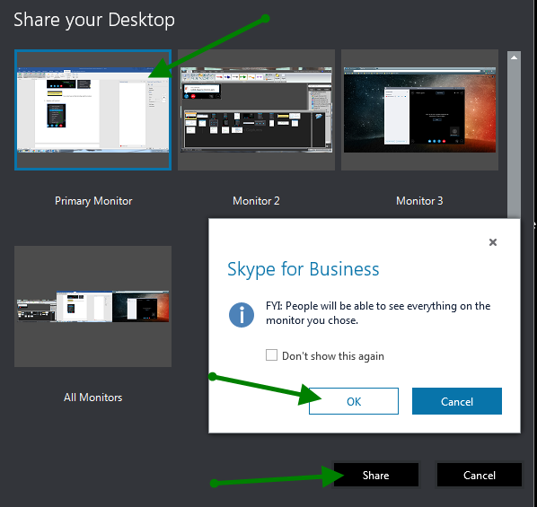
Desktop Sharing
Learning Objectives
How to share your desktop
Make NIC presenter
How to share a share participants desktop

Slide 11
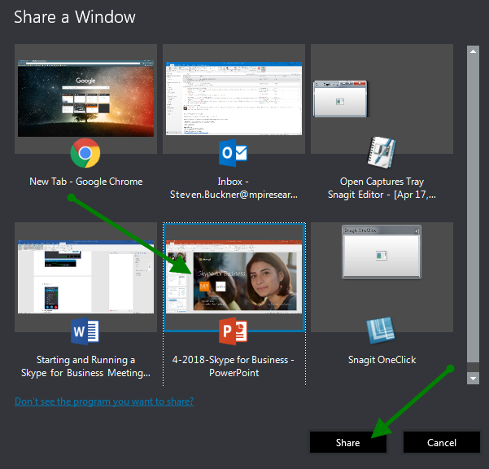
Sharing a window
Learning Objectives
How is this different from sharing your desktop?
How to share a window.

Slide 12
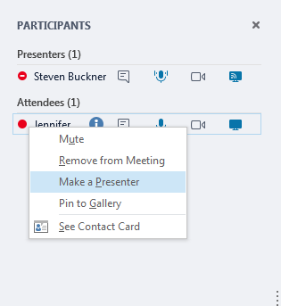
Managing a single participant
Learning Objectives
Change presenter, make the attendee a presenter to share his or her screen.
Mute the attendee.
Remove the attendee from the meeting.

Slide 13
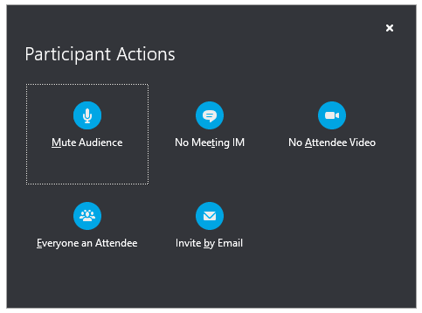
Managing multiple meeting participants
Learning Objectives
Muting participant(s).
Disabling video.

Slide 14
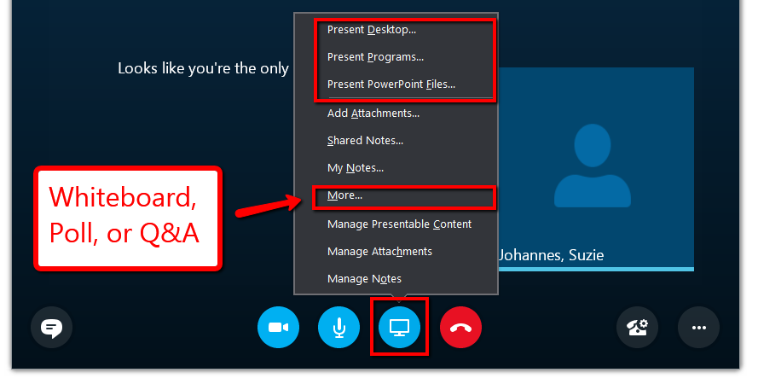
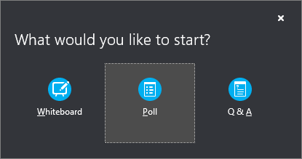
Tools for Collaboration
Learning Objectives
Whiteboard
Poll
Q&A

Slide 15
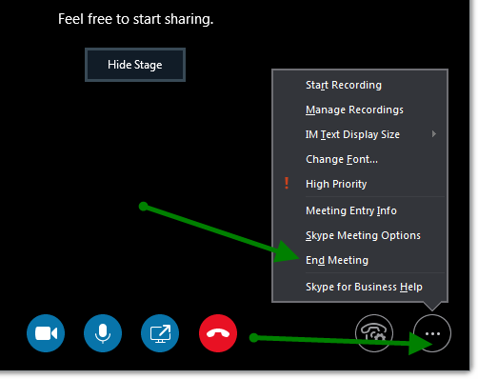
Ending a meeting
Learning Objectives
How to end a meeting

